Slide 1
The Cybersecurity Mindset
Cybersecurity 101 Day 1

Slide 2
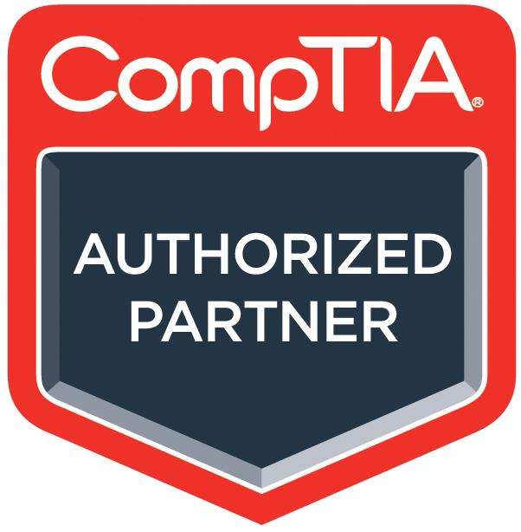

CompTIA Partnership
As part of the course, all students will receive:
Access to CompTIA CertMaster Practice for Security+
An adaptive knowledge assessment and certification training companion tool that will help you gain knowledge and prepare for the Security+ CompTIA exam.
Features question-first design, real-time learning analytics, and content refreshers to help reinforce and test what you know and close knowledge gaps.
You will receive access partway through the course.
CompTIA Security+ exam voucher
Exam vouchers are valid for 12 months.
You will receive it at the end of course, in order to give the voucher the longest shelf-life possible and give you time to study.

Slide 3
Class Objectives
By the end of today’s class, you will be able to:
Explain the course structure and general direction of the program.
Recognize the high-level security strategies and tools covered in class.
Explain how cybersecurity is an assessment of threats and mitigation of risks.
List different types of user, web, server, and database cybersecurity attacks.
Identify risk mitigation plan framework for user, web server, and database attacks.

Slide 4
The Rising Cyber Threat

Slide 5

Why is cybersecurity such a desired skill these days?
Notes:
Image Source: AdobeStock_125741492

Slide 6

Reason 1: Explosive Growth in Dependence of IT
Nearly every personal, social, and commercial aspect of our lives makes contact with vulnerable IT infrastructure.
Notes:
Image sources: Shutterstock_1187923168 (couple at table); shutterstock_415082218 (online shopping); shutterstock_1177745851 (online prescription); shutterstock_1094829206 (online voting)

Slide 7

Reason 2: More Users (Targets) on Connected Devices
More people than ever before are logged into connected devices— often for the majority of their waking (and sleeping) hours.
Notes:
Image source: shutterstock_1075031486

Slide 8
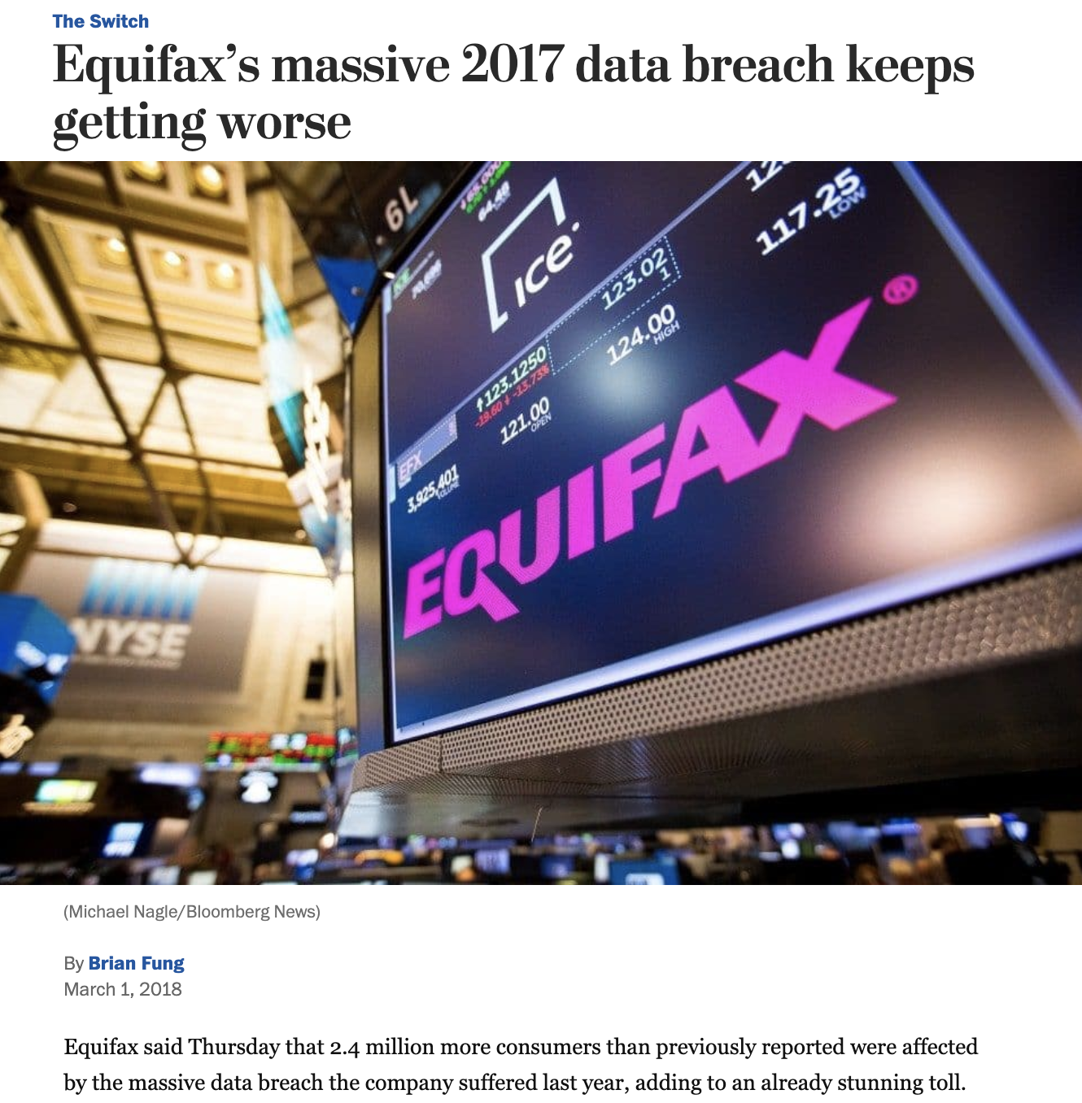
Reason 3: Better Tools for Bigger Damage
Today’s cyber attacks are becoming more sophisticated, aggressive and disruptive than ever before.
Notes:
Low-Risk Image: Source https://www.washingtonpost.com/news/the-switch/wp/2018/03/01/equifax-keeps-finding-millions-more-people-who-were-affected-by-its-massive-data-breach/?noredirect=on&utm_term=.f63014925b4a

Slide 9
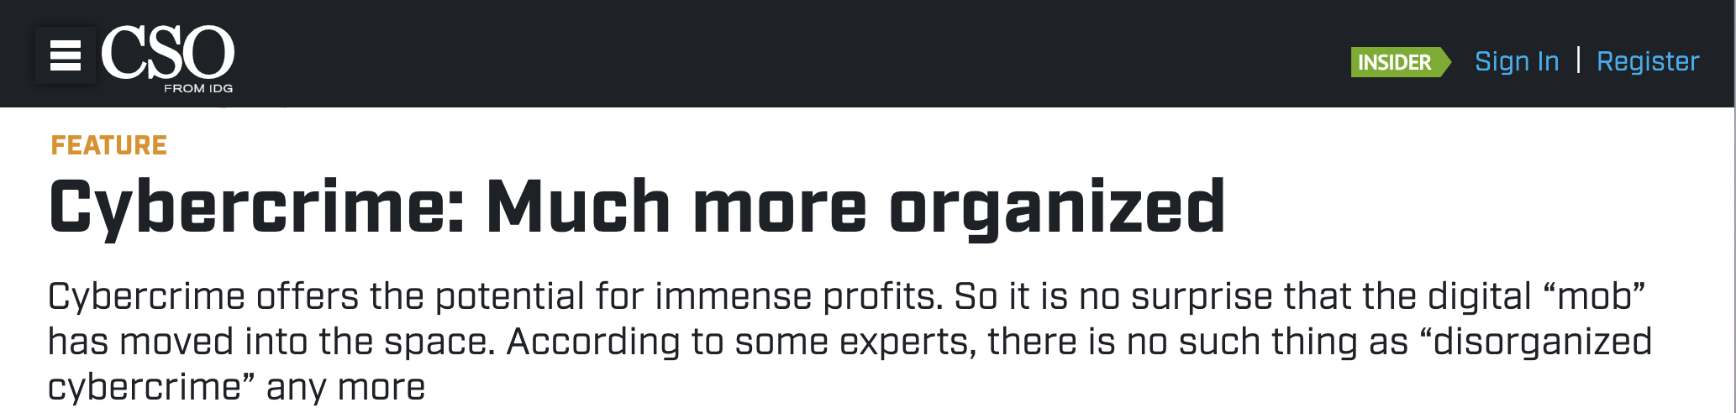
Reason 4: Significant Investment by Bad Actors
Where once the field was populated by individual “lone hackers”, today it has become a focal point for organized crime, nation states, and private enterprises.
Notes:
Headline source: https://www.csoonline.com/article/2938529/cybercrime-much-more-organized.html

Slide 10

Reason 5: Dire Shortage of Skilled Professionals
According to studies by (ISC)², there will be over 1.5 million unfilled cybersecurity positions by 2020.
“70% of cyber security professionals say that their organization has been impacted by the ongoing global cybersecurity skills shortage.”
Notes:
Quote Source: ESG Research Report, The Life and Times of Cybersecurity Professionals, November 2017
Image source: shutterstock_741657592

Slide 11
Defining Cybersecurity

Slide 12
What is the first thing you think of when you hear cybersecurity?
Notes:
Image Source: AdobeStock_125741492

Slide 13

Everyone’s First Thoughts:
Hackers and Complicated Code...
Notes:
Image sources: shutterstock_581898457 (hoodie person in background); shutterstock_635676176 (HACKER word and code overlay)

Slide 14
But cybersecurity isn’t about
complicated code and hackers...

Slide 15

Cybersecurity is really about assessing threats and mitigating risks.
Notes:
Image source: Mike Mirandi

Slide 16

Assessing Threats: A Wild USB Appears!
Let’s say we found a USB drive laying on the ground. How much of a threat could that really be?
Let’s find out!
Notes:
Image source: shutterstock_131952674

Slide 17




Quick Activity: A Wild USB Appears!
Turn to the person next to you and discuss what could happen.
How might it be that a USB drive is able to immediately execute running code?
Why can’t our computer stop the drive from running?
How might we defend against malevolent USBs like this?
Suggested Time: 5 Minutes

Slide 18
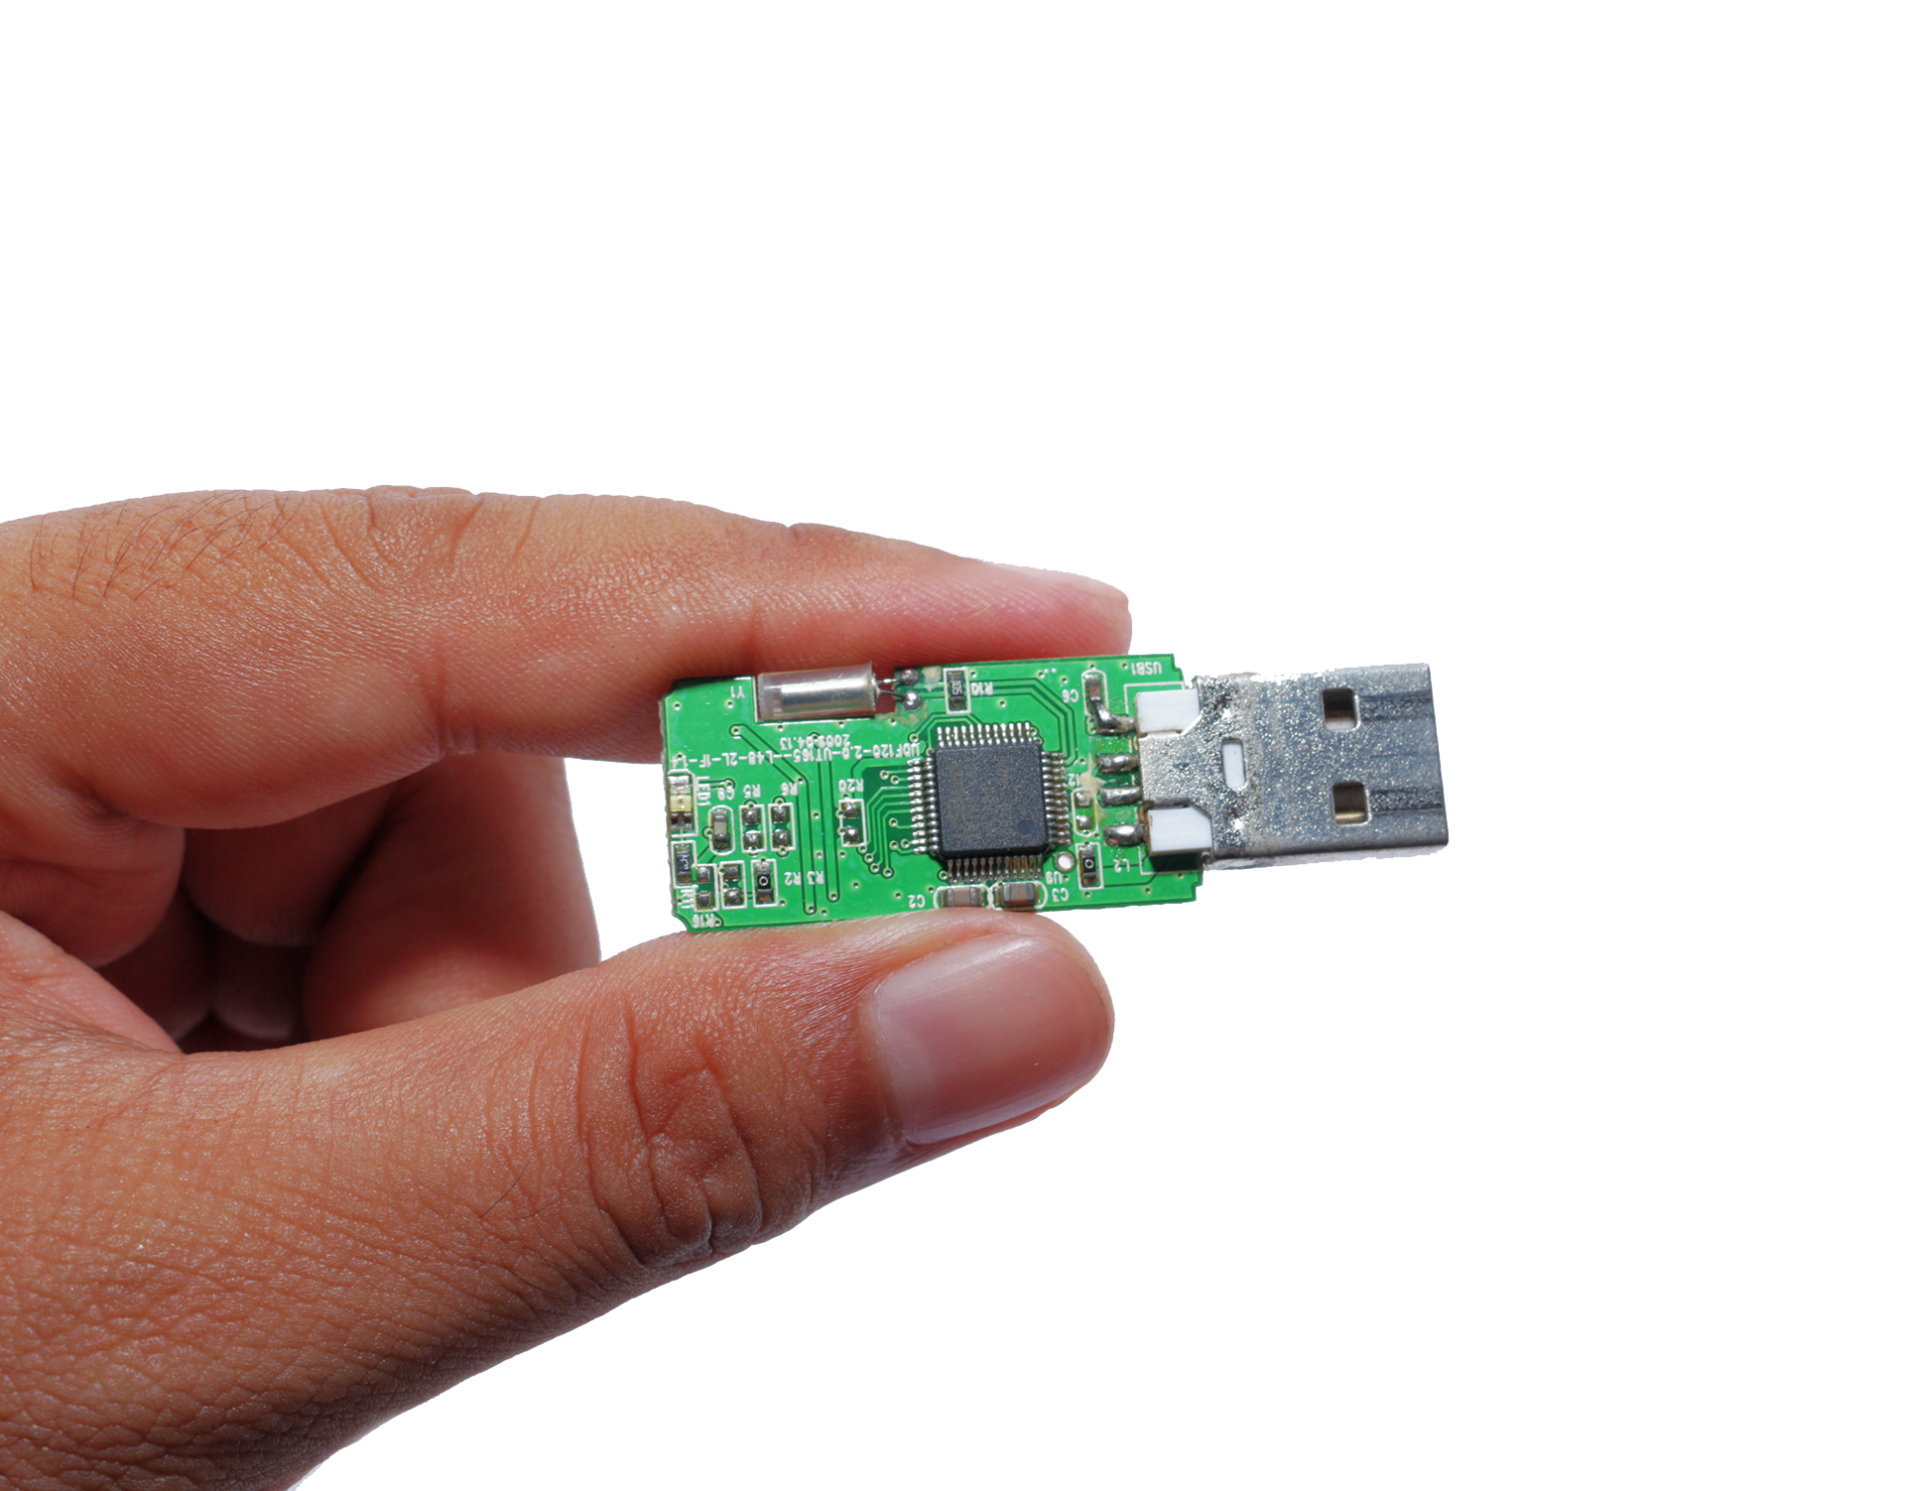
A Harmless USB?
What if the USB was a mini keyboard emulator:
When connected, our computer registers it as a keyboard allowing it to kick off without restriction.
Like most threats, their appearances are deceptive and seemingly safe.
Notes:
Image source: shutterstock_1280708755

Slide 19

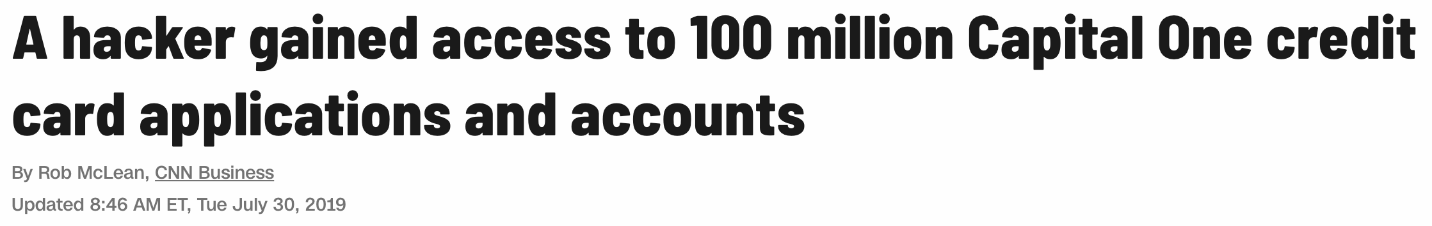
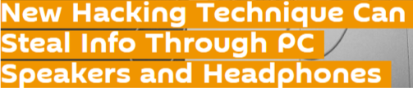
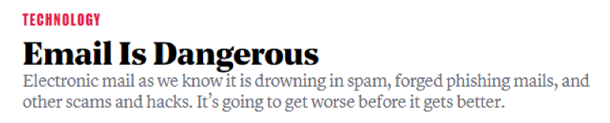
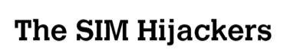
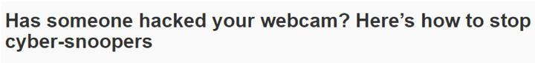

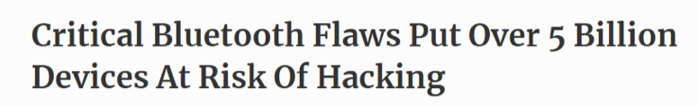
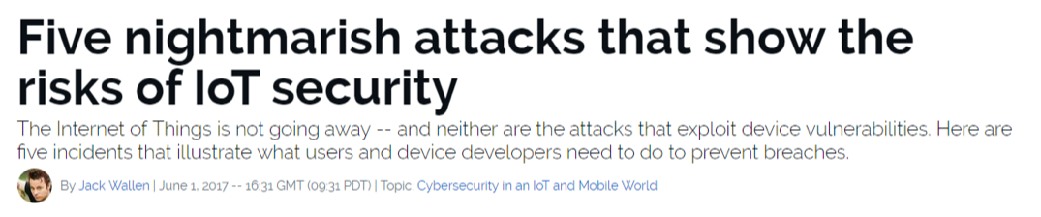
Know the Threats
To the experienced cybersecurity professional, risks are everywhere.
Notes:
Image source: shutterstock_1007525926

Slide 20

Mitigating Risks
Historically, organizations viewed cybersecurity from the lens of the castle model: managing risks meant building walls and keeping the bad actors out.
Today, security professionals operate in a world where breach is assumed, and the risks associated with such events also need to be mitigated.
Notes:
Image sources: shutterstock_600449171 (castle); shutterstock_1014968650 (horse)

Slide 21
Course Overview

Slide 22
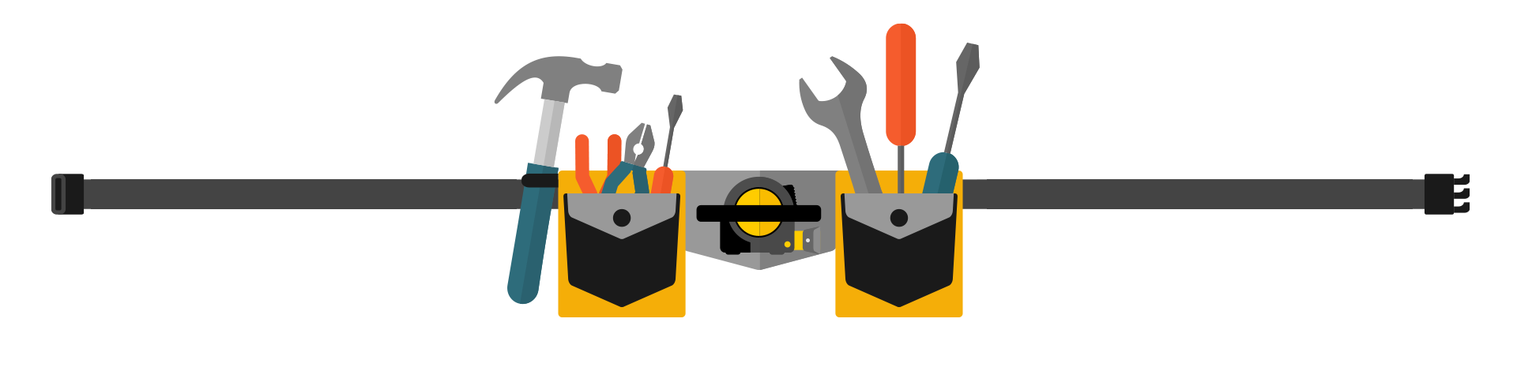
Our Future Tool Belt
Our Goals:
Our Tools:
Threat Assessment
Risk Mitigation
Network Security
Web Security
OS Security
Cryptography
Penetration Testing
Vulnerability Assessment
Security Policy
Risk Analysis
Compliance Strategy
Operational Security
UNIX Command Line
Wireshark
Kali Linux
Nmap
Nessus
Metasploit
Burp Suite
SIEMS and more...
Notes:
Image source: shutterstock_393006970

Slide 23
Daily Routine
In class, we’ll run through the following:
Set Objectives
Brief Background Lecture
Instructor Demonstrations
Thought Exercises
In-Class Skill Builders
Project Work

Slide 24
Curriculum at a Glance
Weeks 1-7 Command Line and Programing
First, we will undertake a rigorous exposure to Unix,
the command line, Linux, Wireshark, networking,
encryption, hashing, and malware analysis.
 | Week 1
 | Week 2
 | Week 3
 | Week 4
 | Week 5
 | Week 6
 | Week 7
 | Week 8
 | Week 9
 | Week 10
 | Week 11
 | Week 12
 | Week 13
 | Week 14
 | Week 15
 | Week 16
 | Week 17
 | Week 18
 | Week 19
 | Week 20
 | Week 21
 | Week 22
 | Week 23
 | Week 24
Weeks 8-13 System Admin and Web Vulnerabilities
We will dive into Linux system administration, web
development and website attacks. We will use
tools like Burp Suite, Snort, and Network Inspector.
Weeks 14-21 Defensive and Offensive Security
Security Information and Event Management (SIEM),
Incident Response, and Forensics are covered in depth,
followed by two weeks of penetration testing.
Weeks 22-24: Test Prep and Group Project
In the final weeks we’ll focus on test prep and a final project.

Slide 25
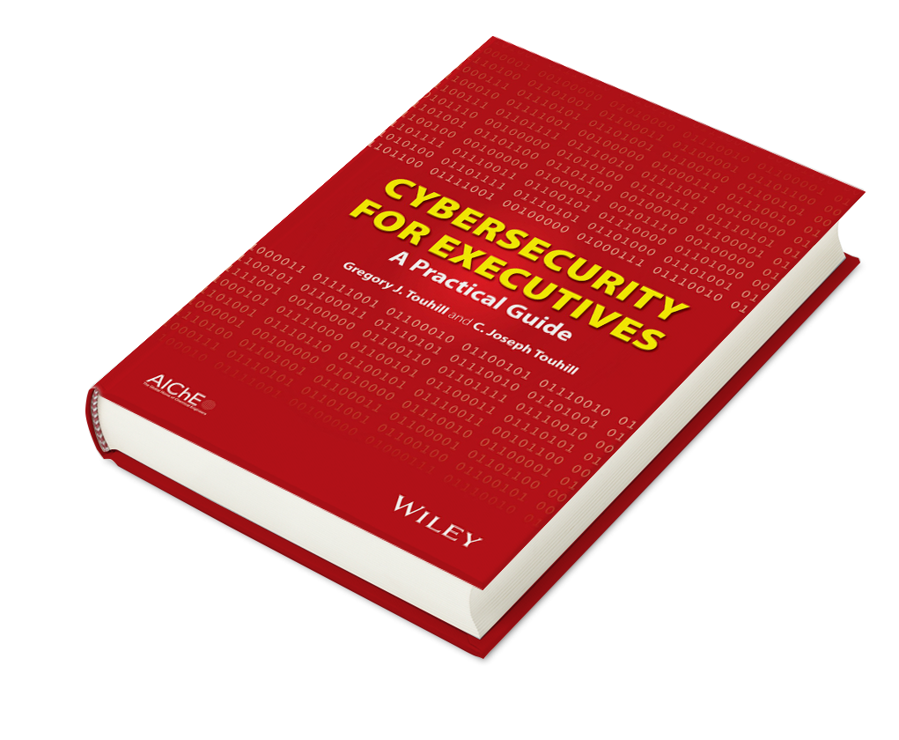
Example Activity: Cybersecurity Policy and Strategy
We’ll learn how to talk about cybersecurity risks, strategy, and policy in a broad organizational and business capacity.
Cybersecurity for Executives: A Practical Guide, by Gregory J. Touhill (Author), C. Joseph Touhill (Author), Wiley-AIChE, ©2014
Notes:
Image source: shutterstock_199262867

Slide 26
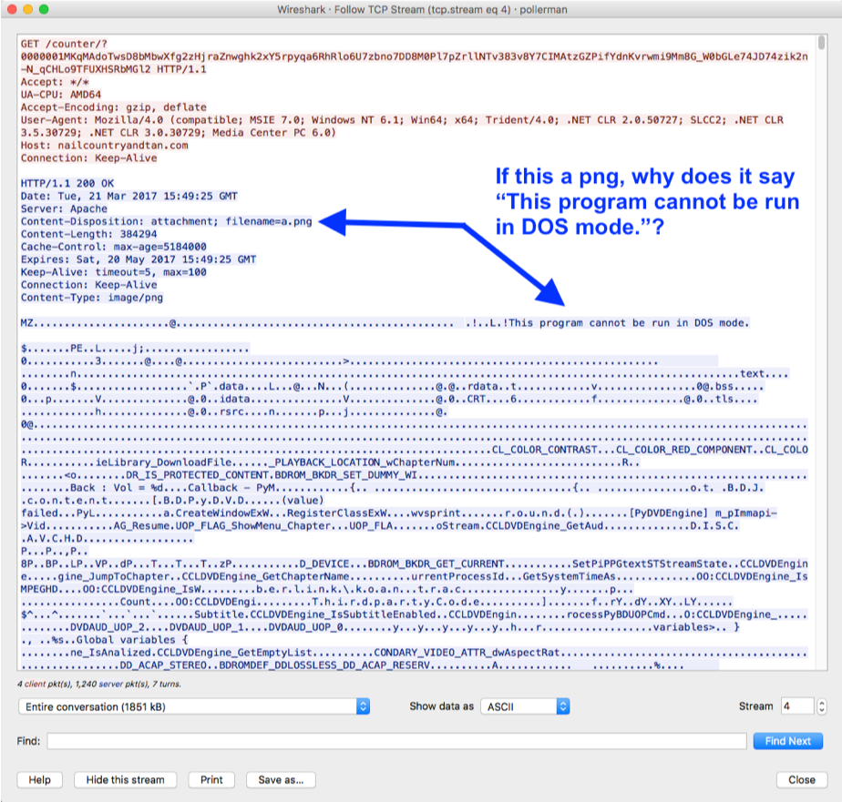
Example Activity: Analyzing Web Traffic for Malware
We’ll learn to process complex network traffic logs in order to find evidence of malware being sent across networks.

Slide 27

Example Activity: Encryption / Decryption Systems
We’ll learn how modern cryptography works and how historic methods of encryption could be broken through simple means.
Plaintext
Ciphertext
Encryption
Readable Message, File or Data
Encrypted Message, File or Data
Key(s)
hello!
5a8dd3ad0756a93ded72b823b19dd877
Decryption

Slide 28




Example Activity: Web Application Hardening
We’ll learn how web applications can be defended against the most common attacks.
1. Attacker sends a script-injected link to victim (an email scam).
1
2
2. Victim clicks on link and requests legitimate website.
Attacker
Victim
4
10101001
100101010110101001111010100101010100010001010100010100111010100110010001100101001
3
4. Malicious script sends victim’s private data to attacker.
3. Victim’s browser loads legitimate site but also executes malicious script.

Slide 29
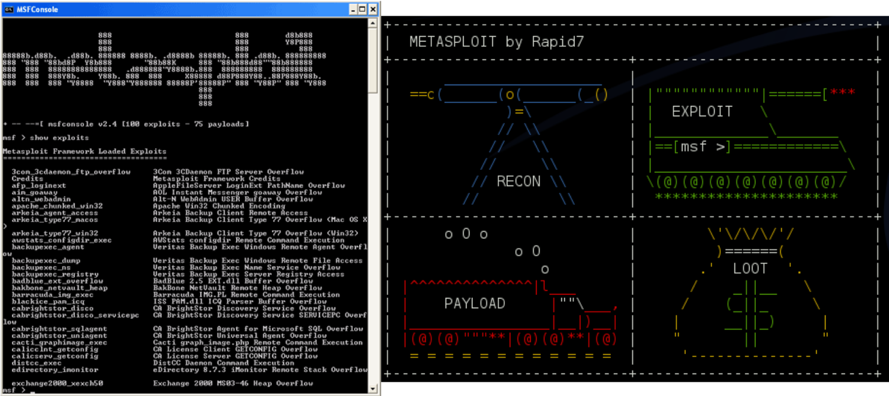
Example Activity:
Identify Vulnerabilities in Unpatched Systems
We’ll learn to use tools like Kali Linux, Nmap and Metasploit to run penetration tests to identify known exploits.

Slide 30

Tip:
Embrace
Your
Curiosity
Notes:
Image source: Eelco Viel

Slide 31








Tip: Embrace being a beginner.
Once you admit you “know nothing” (or little) about the many subject areas we covered in this bootcamp, you’ll be able to dig into these new topics and invest the time necessary to succeed.

Slide 32
Tip: Find your community now.
You and your classmates are in this process together. Use each other for help!
You all can bring value to the table. Don’t be afraid to speak up!

Slide 33
Tip: You need to put in the hours.
There is no magic pill. This bootcamp will require time and effort for you to learn and succeed.
This class will challenge you. Make sure to celebrate your progress along the way.

Slide 34

Notes:
Image source: AdobeStock_56885471

Slide 35
Activity: Security Challenge #1:
Attacking the Wall
In this security challenge, you and your group will play the role of security professionals tasked with handling a real-world situation.
Let’s review the scenario first...
15 Minutes

Slide 36

SECURITY CHALLENGE #1
Secure our code? Nah...
We met on BondingThroughBitcoin.com!
Congratulations! You and your team have just been hired by a very successful startup that runs a Bitcoin Dating Exchange.
While their founding team is brilliant, like many start-ups, they don’t know the first thing about security.
Notes:
Image sources: shutterstock_1485124850 and shutterstock_1138455068

Slide 37
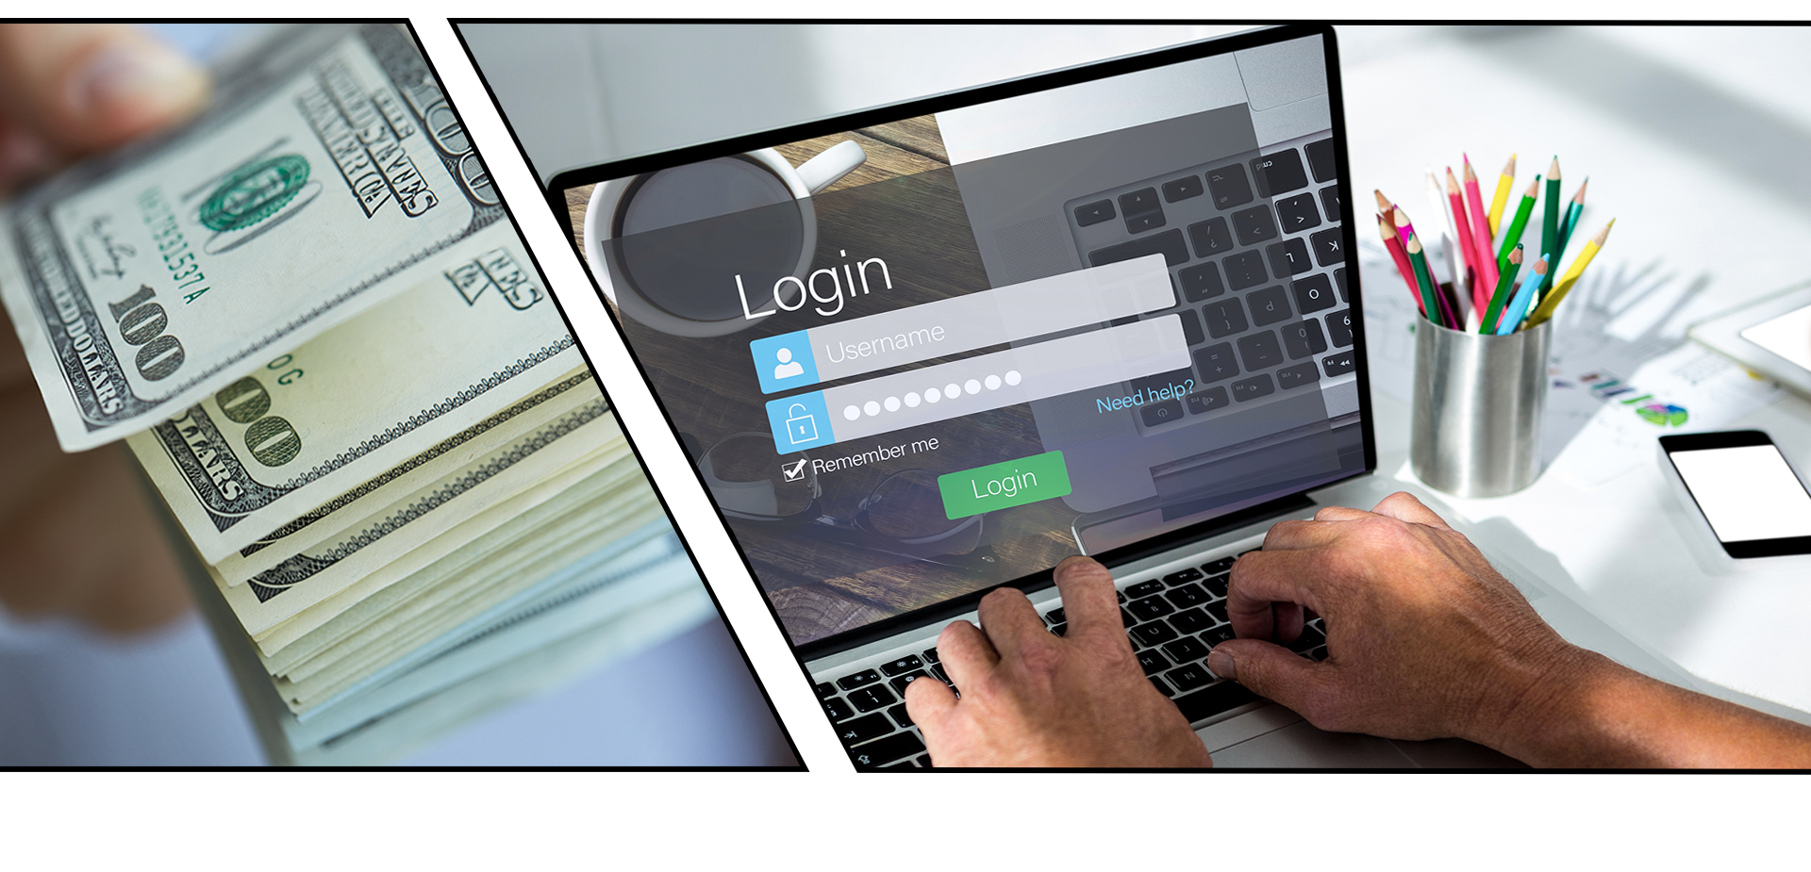
SECURITY CHALLENGE #1
They just handed you a bucket load of cash to solve their single most pressing problem.
Their log-in process is totally insecure. Today, hackers are routinely logging in as users (and administrators) and gaining access to company data and financial assets.
Notes:
Image sources: shutterstock_237968428 and shutterstock_641686837

Slide 38
Activity Instructions: Security Challenge #1: Attacking the Wall
Suggested Time: 15 Minutes
Instructions:
With your group, develop a list of 15 different ways that a malicious actor could penetrate the system and login as a user or administrator.
With each method, be prepared to describe the following:
Who (or what) is the initial target?
How would the actor implement the attack?
Be Prepared to Share!

Slide 39


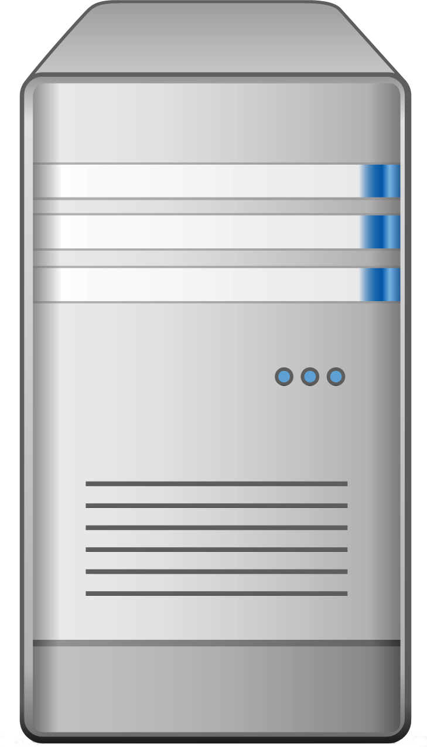

Activity: Security Challenge #1—Attacking the Wall
Web Logins 101
Login
Web Login
Server
Data
We’ll spend a lot more time talking about web logins later in this course, but for now we’ll use this diagram as a guide.
Users and Admins

Slide 40
Activity: Security Challenge #1—Attacking the Wall
Web Logins 101
Login
Web Login
Server
Data
Defend this at all costs!
Users and Admins

Slide 41
Step #1:
Assess the Target

Slide 42
Activity: Security Challenge #1—Attacking the Wall
A Lot of Targets
Login
Web Login
Server
Data
In this case, an attacker can target
every node along the chain.
Users and Admins

Slide 43
Activity: Security Challenge #1—Attacking the Wall
User Attacks
Login
Web Login
Server
Data
Users are subject to a variety of social engineering tactics.
Users and Admins

Slide 44
Activity: Security Challenge #1—Attacking the Wall
Web Attacks
Login
Web Login
Server
Data
Websites are vulnerable to a broad set of code related attacks.
Users and Admins

Slide 45
Activity: Security Challenge #1—Attacking the Wall
Server Attacks
Login
Web Login
Server
Data
Servers are vulnerable to a host of operating system exploits and attacks.
Users and Admins

Slide 46
Activity: Security Challenge #1—Attacking the Wall
Data Center Attacks
Login
Web Login
Server
Data
Data Centers are vulnerable to physical and cloud attacks.
Users and Admins

Slide 47
Step #2:
Define Attack Strategy

Slide 48
Step 2: Defining Attack Strategies
Attack Option #1: Social Engineering
A hacker can ask users for their credentials by falsely pretending to be an administrator.
Fake Admin

Slide 49
Step 2: Defining Attack Strategies
Attack Option #2: Phishing
A hacker can attempt a phishing attack where users are redirected to fake login pages to capture user credentials.
Fake Login
Login
Login

Slide 50
Step 2: Defining Attack Strategies
Attack Option #3: Credential Reuse
A hacker can find users’ login and password information from other websites.
Recycled password
Login
Login
Login

Slide 51
Step 2: Defining Attack Strategies
Attack Option #4: Malware
A hacker could deploy malware such as spyware or keyloggers to capture daily user activity.
Login
Malware

Slide 52
Step 2: Defining Attack Strategies
Attack Option #5: Man in the Middle Attack
A hacker can create a man in the middle attack by providing a free Wi-Fi hotspot to capture user credentials.
WiFi
Login
Shady WiFi

Slide 53
Step 2: Defining Attack Strategies
Attack Option #6: Sniff Packet
A hacker can sniff packet traffic across insecure wireless networks such as a cafe or restaurant.
Packet Sniff
WiFi
Login

Slide 54
Step 2: Defining Attack Strategies
Attack Option #7: Stolen Hardware
A hacker can simply steal a computer and use the saved credentials to login.
Login
Stolen Laptop

Slide 55
Next: website attacks.

Slide 56
Step 2: Defining Attack Strategies
Attack Option #8: Brute Force Attack
A hacker could simply utilize a Brute-Force Attack to attempt a continual battery of username and password combinations.
Username: bob@bbb.com Password: Love
Username: bob@bbb.com Password: Love123
Username: bob@bbb.com Password: Love123!
Username: bob@bbb.com Password: L@ve123
Login
Password Dictionary

Slide 57
Step 2: Defining Attack Strategies
Attack Option #9: Code-Injection
A hacker could utilize a code-injection attack in which malicious code is directly injected into the username or password fields.
Username:
uName = getRequestString("username");
uPass = getRequestString("userpassword");
sql = 'SELECT * FROM Users WHERE Name ="' + uName + '" AND Pass ="' + uPass + '"'
Login
Password Dictionary

Slide 58
Step 2: Defining Attack Strategies
Attack Option #10: Faulty Session Management
A hacker could exploit faulty session management when developers incorrectly implement code used to maintain login and logouts.
{}
SessionID Swap
Login
{}

Slide 59
Next: server attacks.

Slide 60
Step 2: Defining Attack Strategies
Attack Option #11: OS Exploits
Servers, which run on operating systems like Windows and Linux, are subject to OS exploits when incorrectly patched.
Vulnerable OS

Slide 61
Finally: database attacks.

Slide 62
Step 2: Defining Attack Strategies
Attack Option #13: Default Credentials
Database management systems often come with default credentials that may be left unchanged.
Username: postgres
Password= “”
Default Credentials

Slide 63
Step 2: Defining Attack Strategies
Attack Option #14: Unpatched Database
Database management systems may be unpatched against publicly known vulnerabilities.
Unpatched BDMS

Slide 64
Step 2: Defining Attack Strategies
Attack Option #15: Lack of Segregation
The database may be set up to let a client peek at another client’s data.
Lack of Segregation

Slide 65
Security Challenge #2

Slide 66
Activity: Security Challenge #2:
Defending the Wall
Now that we’ve assembled a list of potential attacks, your next task is to develop a list of at least 10 strategies to mitigate the website’s risk of unauthorized access. Be Prepared to Share!
15 Minutes

Slide 67
Activity: Security Challenge #2—Defending the Wall
User Attacks
Web Attacks
Database Attacks
Social Engineering
Brute-Force Attacks
Default Credentials
Phishing Attacks
Code Injection
Unpatched Database
Credential Reuse
Faulty Sessions
Lack of Segregation
Malware Attacks
Man in the Middle
Server Attacks
To help you get started, review this list of identified attack types.
Packet Sniffing
OS Exploit
Computer Theft
Malicious Software

Slide 68
Step Three:
Risk Mitigation Plan

Slide 69
Step 3: Risk Mitigation Plan
User Attacks
Web Attacks
Database Attacks
Social Engineering
Brute-Force Attacks
Default Credentials
Phishing Attacks
Code Injection
Unpatched Database
Credential Reuse
Faulty Sessions
Lack of Segregation
Malware Attacks
Man in the Middle
Server Attacks
Risk Mitigation begins by assessing all risks and looking for parallels.
Packet Sniffing
OS Exploit
Computer Theft
Malicious Software

Slide 70
Step 3: Risk Mitigation Plan
User Attacks
User Risk Mitigation
Educate all users on the danger of phishing and social engineering.
User randomly generated passwords.
Ensure users are employing multifactor authentication (password + phone confirmation).
Use HTTPS and only access sensitive content over secure channels.
Social Engineering
Phishing Attacks
Credential Reuse
Malware Attacks
Man in the Middle
Packet Sniffing
Computer Theft

Slide 71
Step 3: Risk Mitigation Plan
Web Attacks
Web and Server Risk Mitigation
Ensure strong passwords are used (i.e., alphanumeric +symbol + special characters).
Sanitize any input in the web application form fields and filter out.
Ensure users are immediately logged out when closing a browser. (No preservation of login after 30 seconds of inactivity.)
Ensure that all servers are routinely patched against latest know vulnerabilities.
Incorporate antivirus and user education.
Brute-Force Attacks
Code Injection
Faulty Sessions
Server Attacks
OS Exploit
Malicious Software

Slide 72
Step 3: Risk Mitigation Plan
Suggested Plan
Educate all users on the dangers of phishing and social engineering.
Require randomly generated passwords.
Ensure users have multi-factor authentication (password + phone confirmation).
Use HTTPS and only access sensitive content over secure channels.
Ensure strong passwords are used (alphanumeric + symbols).
Sanitize any input in the web application form fields and filter the output.
Ensure users are immediately logged off when closing a browser. (No preservation of login after 30 seconds of inactivity.)
Ensure all servers are routinely patched against latest known vulnerabilities.
Ensure physical access to servers is protected by multiple forms of authentication (login + biometric).
Ensure that all data stored in the database is encrypted and cannot be read without additional login information.
Provide database access on need-to-know basis.
Log and monitor all database access.
Ensure that all cloud security platforms follow best practices for security implementation.
Notes:
As security professionals, we will make our recommendations based on observed risks. In conjunction with our clients, we will also make decisions on the best course of action.

Slide 73
Cybersecurity Framework

Slide 74
Our Cybersecurity Framework
Even in our simple exercise, we can begin to see an emerging framework for addressing cybersecurity threats.
IDENTIFY
TARGETS
DETERMINE ATTACKS
MITIGATE RISKS

Slide 75
NIST Cybersecurity Framework
As we progress through class, we’ll begin to understand larger frameworks for addressing cybersecurity threats.
IDENTIFY
PROTECT
DETECT
RESPOND
RECOVER

Slide 76
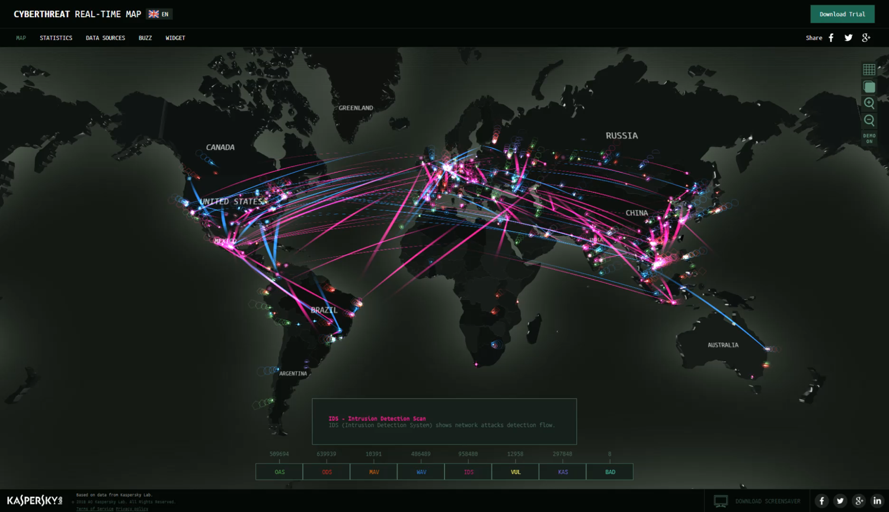
Next Class…
We’ll dive deeper into today’s threat landscape and discuss modern day cyber security tasks.
Notes:
Screengrab: from https://cybermap.kaspersky.com/

Slide 77
Any Questions?

